Slide 1
Structural design patterns

Slide 2
Structural Design Patterns

Slide 3
Structural Design Patterns
Each of these patterns will help you create a structure for your application architecture in a variety of scenarios.
You will learn how to create composite objects, how to connect to orthogonal class hierarchies together, how to enhance an existing object.
The structural patterns are based on the way in which a set of classes are related to each other to provide a complex functionality, providing a structure to achieve that goal.

Slide 4
Structural Design Patterns
Adapter
Bridge
Composite
Decorator
Facade
Proxy

Slide 5
El público está más familiarizado con el mal diseño que con el buen diseño. En realidad está condicionado para que prefiera el mal diseño porque es con el que vive. Lo nuevo le parece amenazador, lo viejo le da seguridad. Paul Rand

Slide 6

Adapter

Slide 7
Intent
Convert the interface of one class into another
Wrap an existing class with a new interface
Introduce a legacy component into a new system

Slide 8
Benefits
Adapters greatly improve code reuse
You can reuse code across different platforms

Slide 9
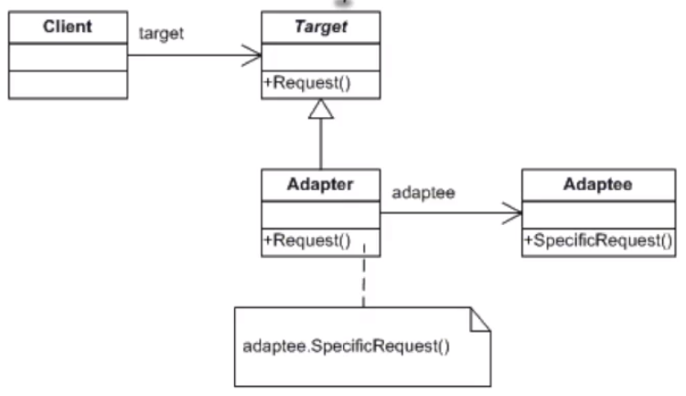
UML

Slide 10
Checklist
Identify all three actors in this pattern: the client, the adaptee and the adapter.
Identify the interface that the client requires, and put it in an abstract target class
Derive a concrete adapter class from the abstract target base class.
Write the adapter code to map the client interface to the adaptee interface, and place it in the adapter class
Modify the client to use the adapter every time it needs to access the adaptee

Slide 11
Final Comments
An Adapter make things work after they are designed, a Bridge make things work before they are designed
An Adapter expose the same interface, and a Decorator exposes an enhanced interface
An Adapter changes the interface of an existing object, a Decorator enhances an object without changing its interface.
A Facade defines a new interface, an Adapter reuses an existing interface.

Slide 12
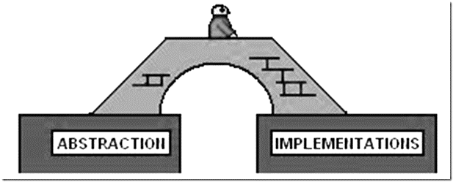
Bridge Pattern

Slide 13
Intent
Combine two or more orthogonal class hierarchies
Bind an implementation to a class at runtime
Clean up a proliferation of classes resulting from an interface coupled with lots of implementations
Share an implementation among multiple objects

Slide 14
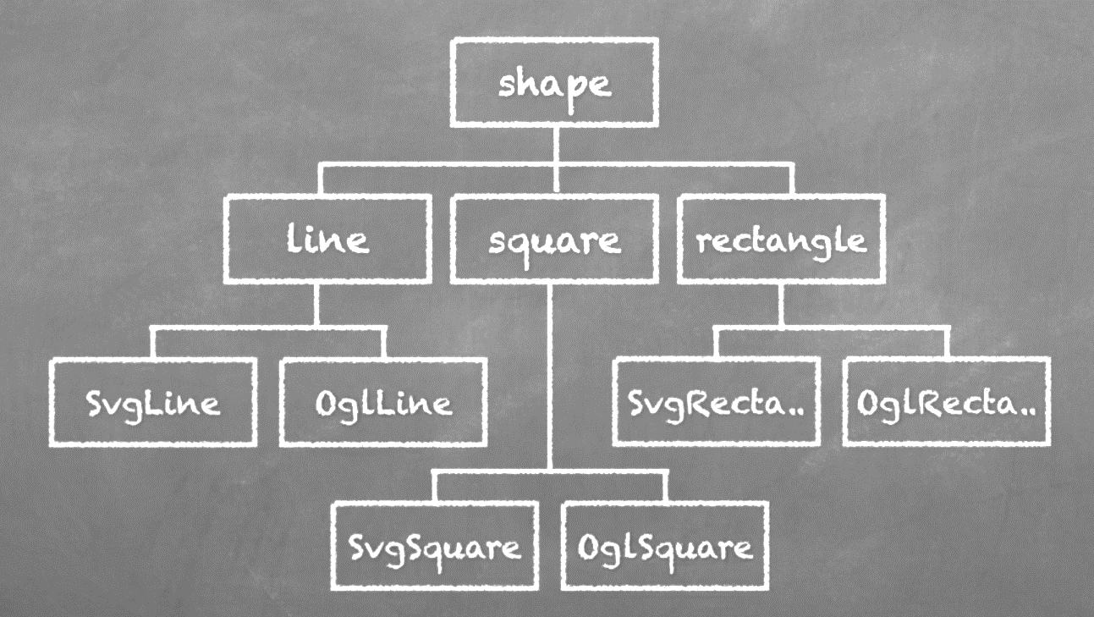
Orthogonal classes hierarchies

Slide 15
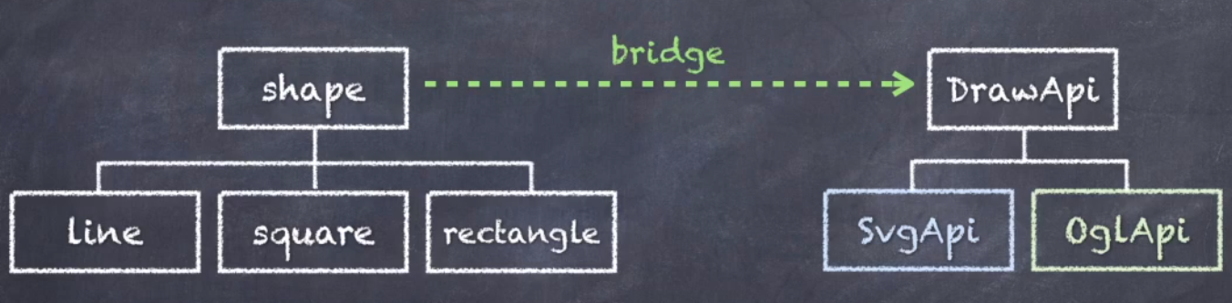
Bridge Pattern

Slide 16
Benefits
Reduces the number of classes
Improves code maintainability
Define an interface at compile time and specify the actual implementation at runtime
Provides the freedom to make future changes.

Slide 17
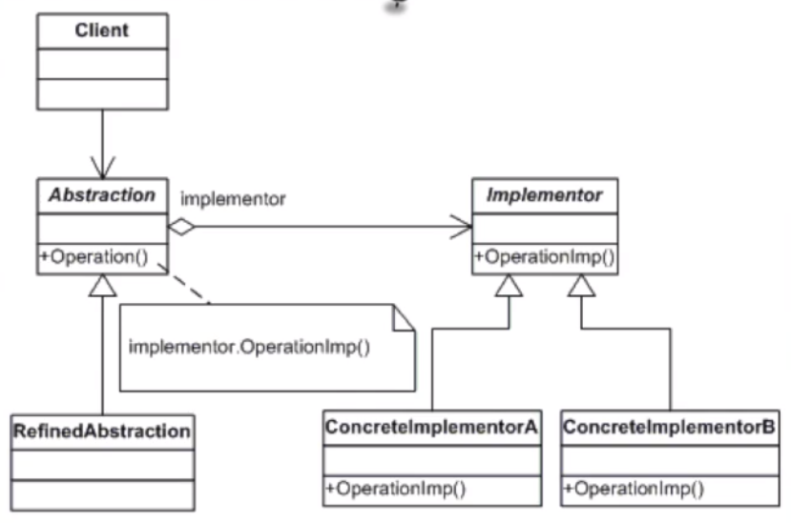
UML

Slide 18
Checklist
Identify two or more orthogonal class hierarchies
Design an abstract client oriented interface that defines what the client wants
Design an abstract platform oriented interface that defines what the platform provides.
Add derived specialization classes for each concrete abstraction and map the client interface to the platform interface.
Add derived classes for each concrete platform

Slide 19
Final Comments
An adapter make things work after they’re designed, a Bridge makes them work before they are.
A bridge is designed upfront to let abstraction and implementation vary independently, an Adapter is retrofitted to make unrelated classes work together.
You can use the Abstract Factory pattern to create implementation objects

Slide 20
Bridge Pattern
The Bridge pattern lets you combine two or more orthogonal class hierarchies.
The pattern reduces the number of classes in your code and concentrates all implementation code in its own class hierarchy.
The pattern provides the freedom to make changes to interface and implementation without breaking the architecture.
You can provide the implementation at runtime by using an abstract factory to create the implementation objects.
The pattern is similar to the Adapter pattern but is intended for decoupling instead of adapting.

Slide 21
Composite Pattern

Slide 22
Intent
You need a tree structure to represent a part of hierarchy
You want to compose objects out of one or more child objects
You want clients to treat individual objects and compositions of objects in exactly the same way

Slide 23
Benefits
Set up a hierarchy of components
Calling code doesn’t nee to know which components have children and which do not.
Ideal if you are applying a sequence of operations on a tree-like data structure and the calling code doesn’t care if the operation gets applied to a composite or a leaf object.

Slide 24
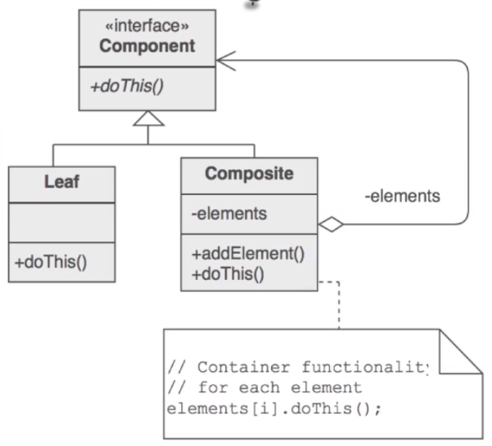
UML

Slide 25
Checklist
Identify all composite objects that are composed of nested child components
Create an abstract Component base class that contains the lowest common denominator interface
Add a derived Leaf class and add any leaf management methods to his class.
Add a derived Composite class and add any child management methods to this class.
Implement the component API for the Leaf and Composite classes
Add as many subclasses of Leaf and Composite as you need

Slide 26

Decorator Pattern

Slide 27
Intent
Attach functionality to an object dynamically
You are enable to use subclassing

Slide 28
Benefits
Allows you to enhance functionality of a method without having to use subclassing
Side-steps the multiple inheritance limitation in C#
Hides the original object beneath layers of decorators

Slide 29
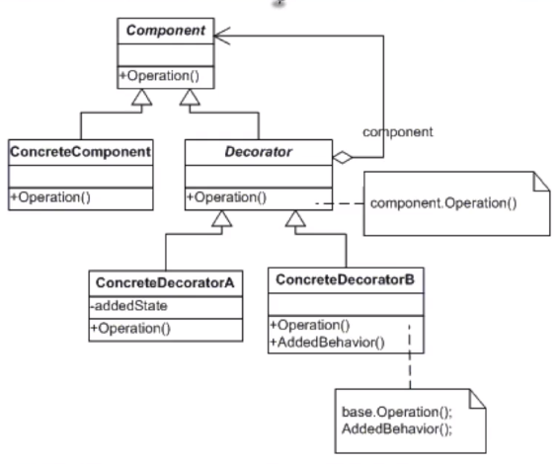
UML

Slide 30
Checklist
Make sure you need to add functionality to an existing class that you cannot subclass and that there is an interface that is common to all.
Create an abstract class with the lowest common denominator component interface
Derive the existing class from the component base class
Define a decorator for each additional piece of functionality
Client defines type and ordering of component and decorator objects

Slide 31
Final Comments
You can view Decorator as a Composite with a single child at each level. But a decorator is intended for adding functionality not object aggregation.
You can combine Decorator and Composite patterns
An Adapter provides a different interface to its subjects, a Proxy provides the same interface, and a Decorator provides an enhanced interface.

Slide 32
Decorator Pattern
A good choice when you want to attach additional functionality to an object dynamically and you are unable to subclass the objects
The pattern treats components and decorators in exactly the same way
The pattern is ideal if you want to apply layers of enhancements to an object operation.
You can combine the Composite and Decorator patterns.

Slide 33
Facade Pattern

Slide 34
Intent
Provide a unified high-level interface to a set of low-level interfaces in a subsystem
Make the subsystem easier to use
Wrap a complicated subsystem with a simpler interface

Slide 35
Benefits
Dramatically reduces the learning curve to successfully interact with the subsystem
The pattern also promotes the decoupling of the subsystem from its many clients

Slide 36
Risks
Power and flexibility is gone when the façade is the only access point of the subsystem.
Freedom to change the subsystem API is significantly reduced if the subsystem remains exposed to clients.
A faced can turn into the God Object anti-pattern.

Slide 37
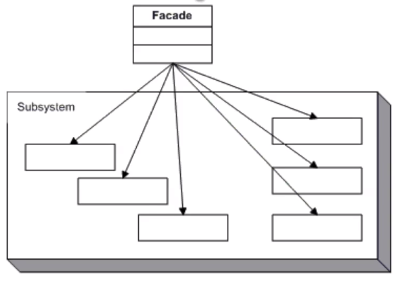
UML

Slide 38
Checklist
Identify a complex subsystem in your application architecture that you want to simplify
Design a simple unified interface for the subsystem.
Create a façade class with the simple unified interface
Have the façade call the appropriate low-level methods to implement the interface
Modify the client to always use the facade

Slide 39
Final Comments
A Façade is often a singleton, Adapters are usually instantiated for every component they wrap.
An Abstract factory is a façade for object creation.

Slide 40
Facade Pattern
Facade provides a unified high-level interface to a complex low-level subsystem to make the subsystem easier to use
The pattern promotes decoupling of the subsystem from its clients, but denying clients access to the low-level interface also reduces power and flexibility.
Facades can evolve into a God Object
Adapter makes legacy components compatible, Facade reduces the learning curve of a complex subsystem
Facades are often singletons, and you can sometimes use an Abstract Factory in a place of Facade.

